Slide 1

Annual Parish Meeting
19:00 to 21:00
Barton Village Hall
23 April 2026

Slide 2
Agenda
Minutes and Matters from 2025
South Cambridgeshire District Council Lisa Redrup
Barton Parish Council
  Chair John Howland-Jackson
  Responsible Financial Officer Ian Minto
  Amenities & Open Spaces Chloe Langford
  Traffic, Transport &Travel Andy Martin
  Communication Ben Pilgrim
Barton Village Charitable Trust John Boocock
Barton Village Hall Margaret Penston
Barton Recreation Ground Improvement Margaret Penston
Barton Bowls Club Hugh Greenfield
Open Forum

Slide 3
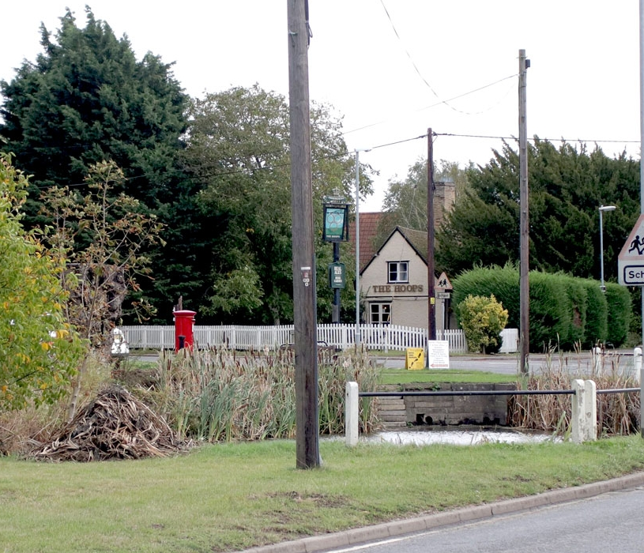
A&OS Working Group Report
By Chloe Langford, Shelley Arora- Tailby, Deni Devappriya, Amy Winterbourne
Green Spaces
The recreation ground
The pond
Lobbying!
Community events
23 April 2026

Slide 4
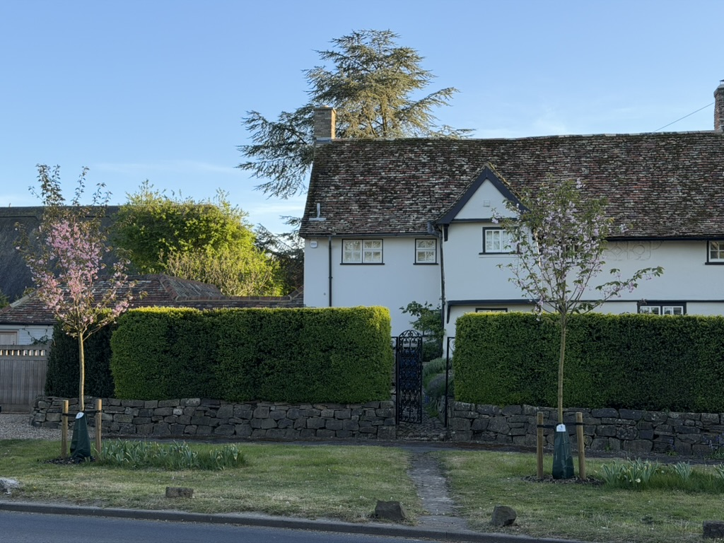
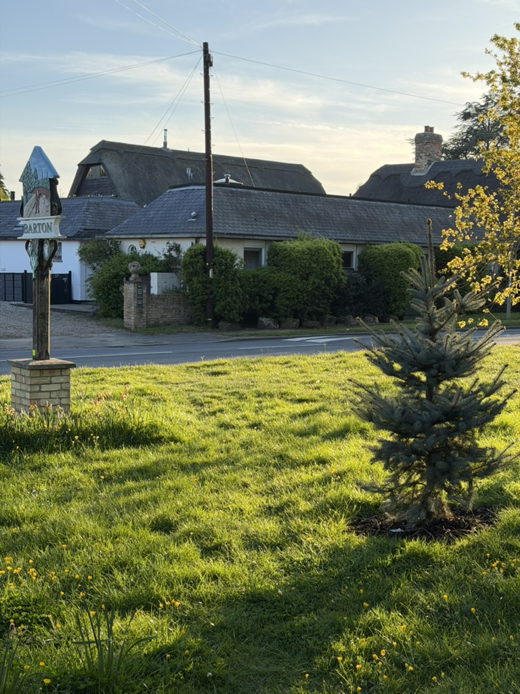
Greenways Landscaping scheme
Annual Parish Meeting
23 April 2026

Slide 5
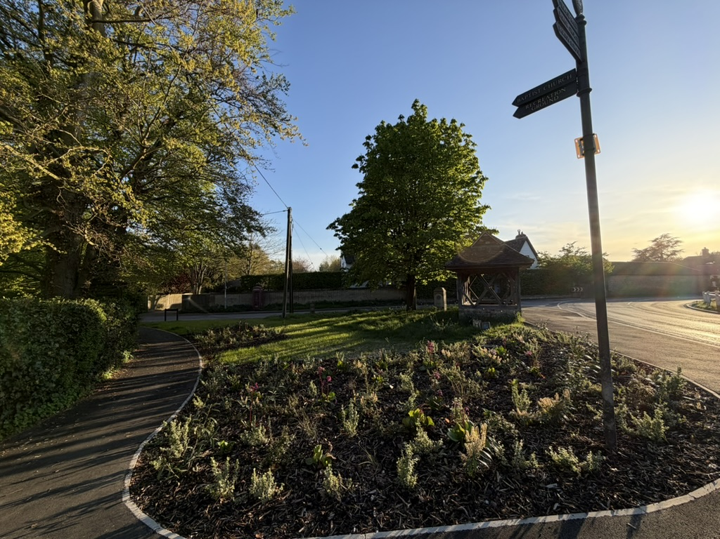
The new “triangle”!
Annual Parish Meeting
23 April 2026

Slide 6
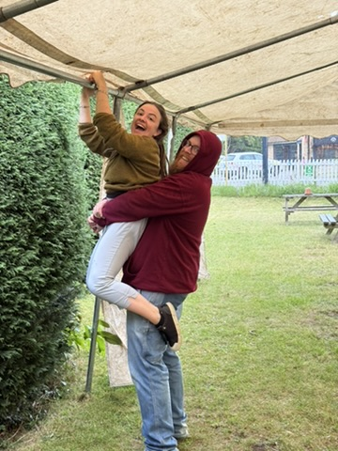
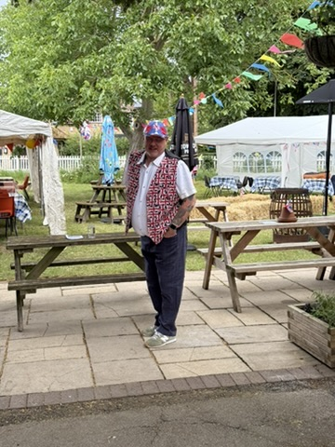
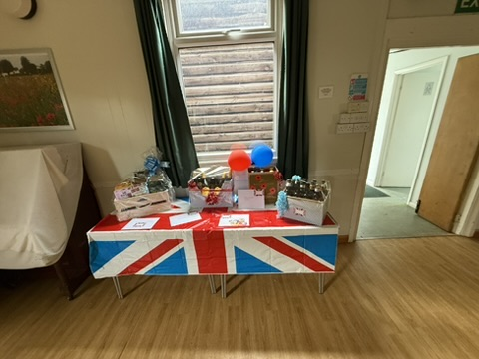
80th VE Day preparations begin…
Annual Parish Meeting
23 April 2026

Slide 7
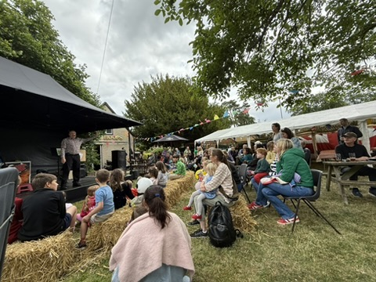
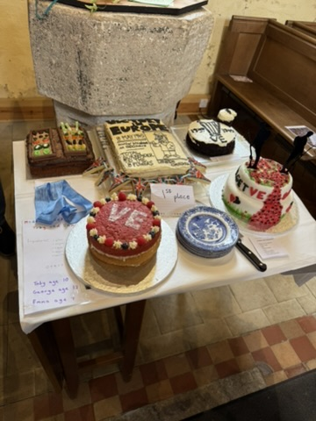
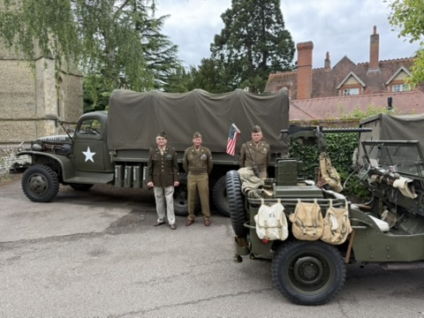
Barton remembers…
Annual Parish Meeting
23 April 2026

Slide 8
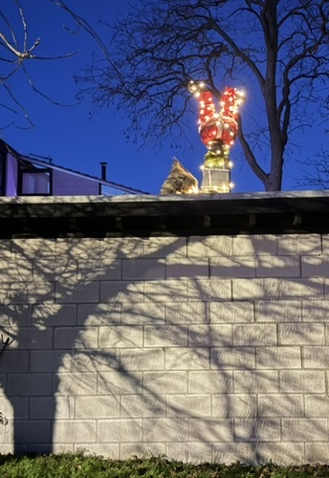
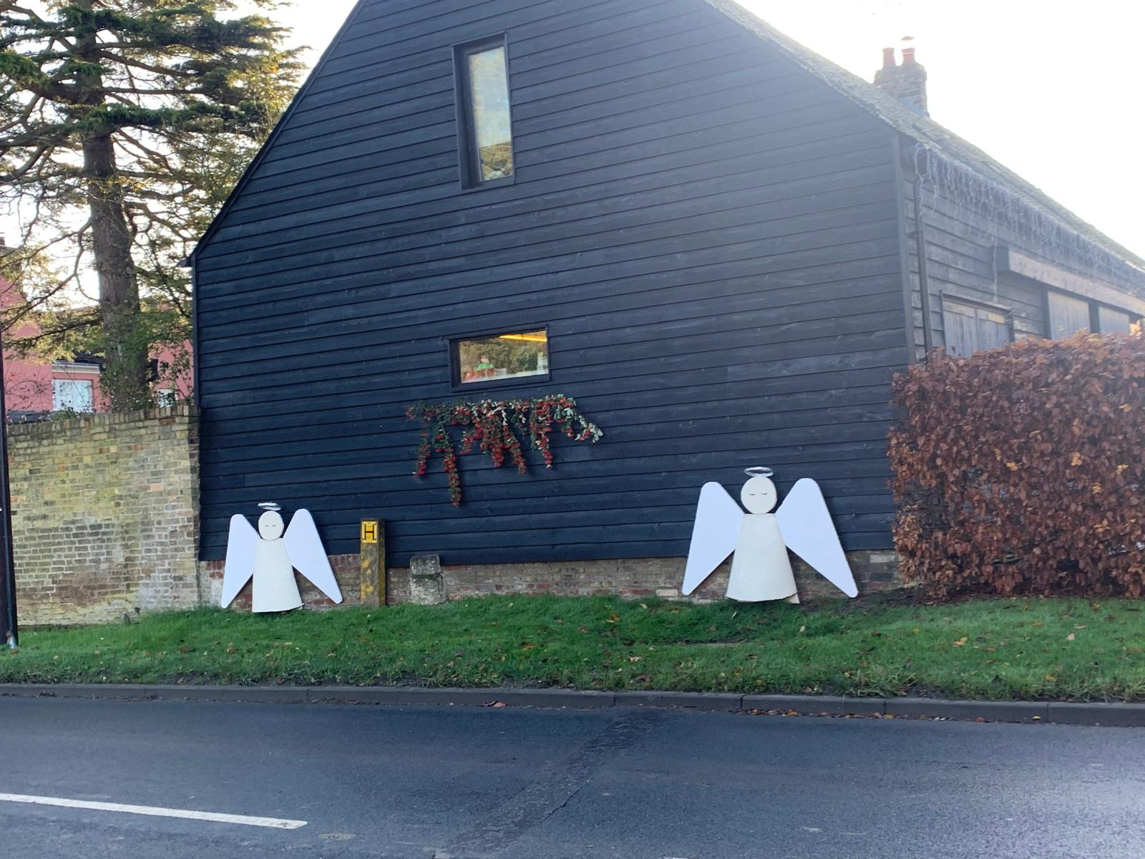
Its the most wonderful time of the year…
Annual Parish Meeting
23 April 2026

Slide 9
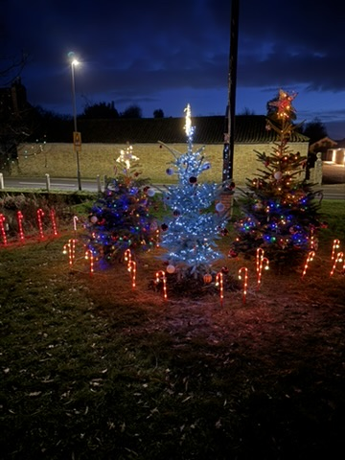
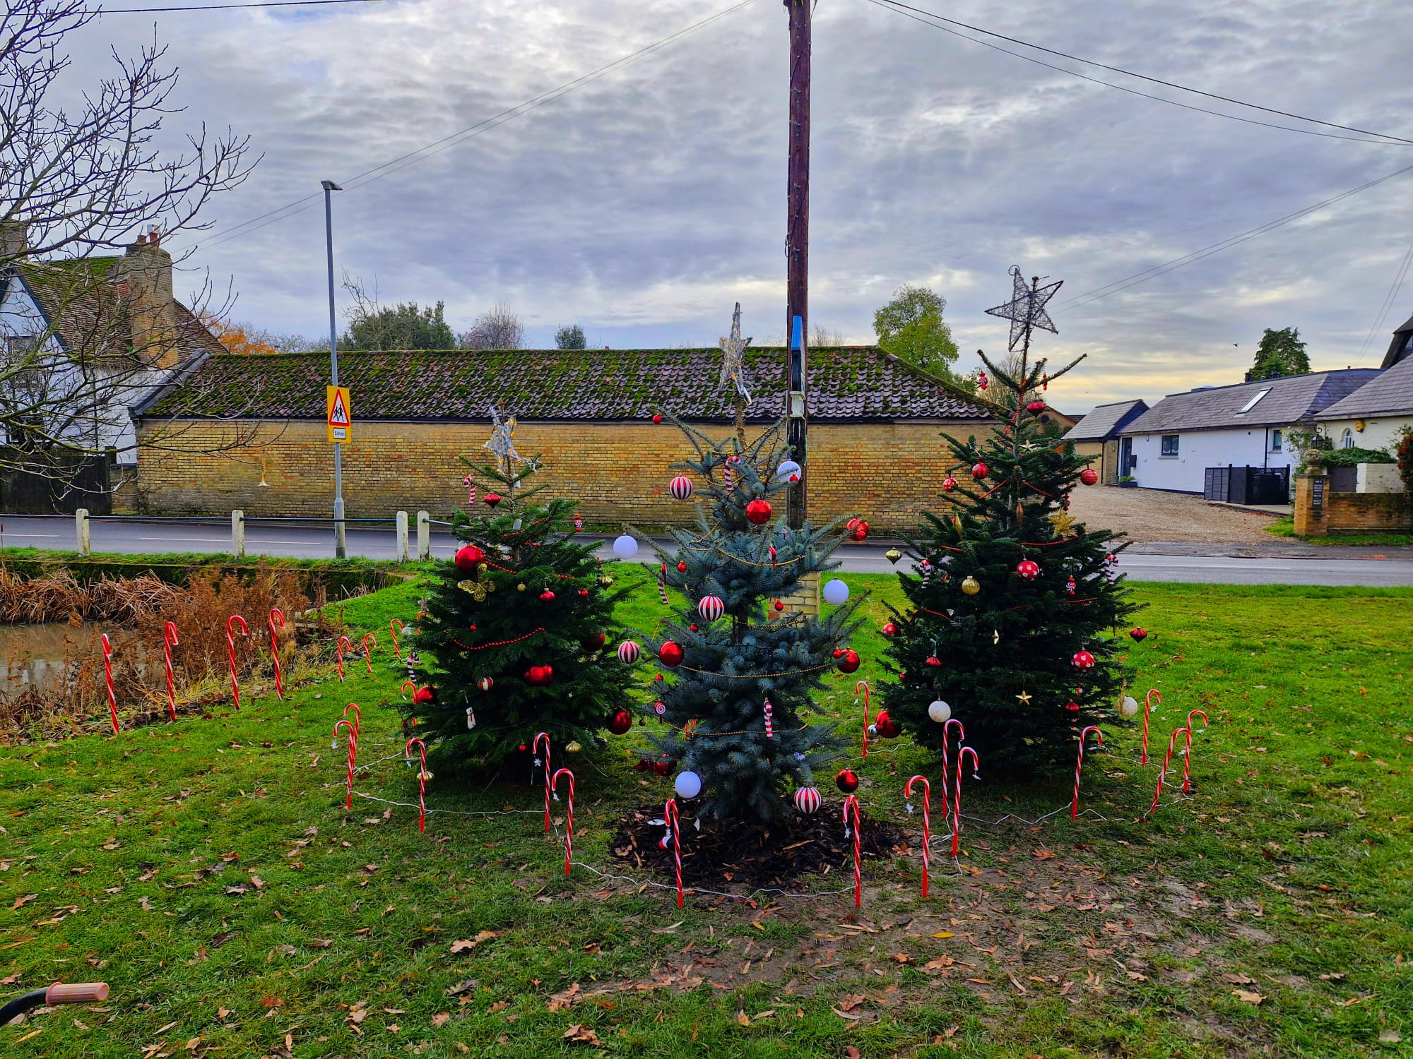
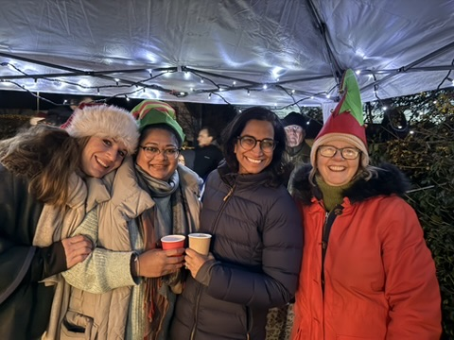
Oh (living) Christmas tree!
Annual Parish Meeting
23 April 2026

Slide 10
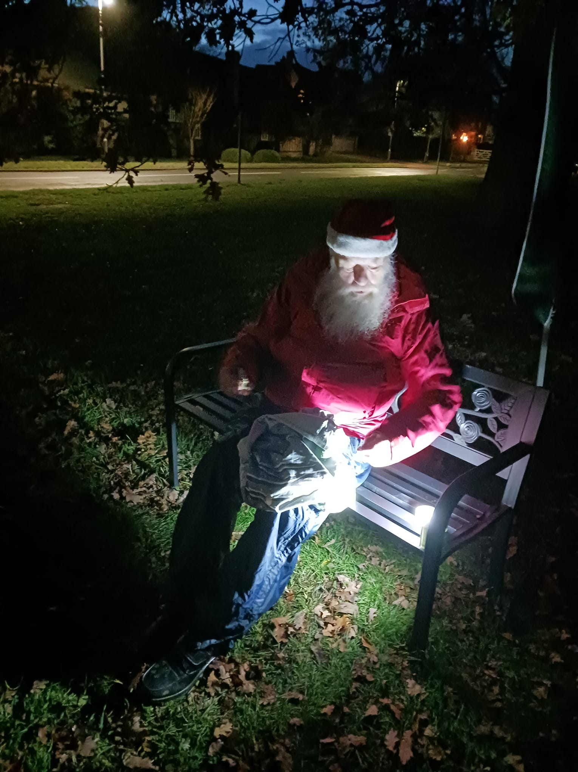
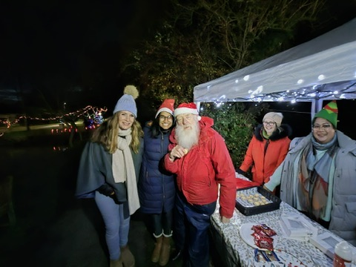
Our favourite special guest!
Annual Parish Meeting
23 April 2026

Slide 11

T, T & T Working Group Report
Andy Martin and Sam Richardson
Village phase: junction changes and traffic calming; two crossings. Still items to complete: parallel crossing; car park; road markings; verges tidying up.
A603 phase: planning decision expected in June/July. Business case has been approved. Details to follow.

Slide 12

East West Rail
Regular meetings with Haslingfield lead: EWR, Bridget Smith; Pippa Heylings.
EWR Public Consultation is currently open. (See posts for details)
Meeting arranged with Lord Peter Hendy (Rail Minister) in London.

Slide 13
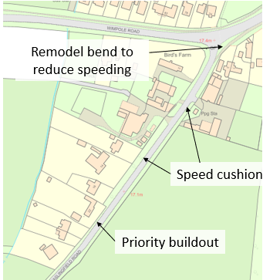
Traffic Calming
Privately Funded Highway Initiative for Haslingfield Road. Waiting on design.
Grant application in for Wimpole Road: speed reduction to 40 mph: village gates; signage changes.
Continue with speed monitors and speed watch.

Slide 14
Communication Working Group Report
By Shelley Arora, Ben Pilgrim, Andy Martin, Deni Devappriya

