Slide 1
Traffic Calming
By Traffic, Transport and Travel Working Group
Mike Radford, Will Westlake and Andy Martin
August 2020

Slide 2
Introduction
Extensive consultation with CCC Highways. Options are apply for LHI grants (£15k per year) and or privately fund (PFHI)
Volume: large developments feeding traffic through the villages
Speed: wide roads, rural feel
Safe Crossing: elderly and children; cyclists and horses
Pollution: through the village
Parking: nuisance parking
Please Provide Feedback and Ranking

Slide 3
Buffer Zones
Drop speed to 40 mph on each approach road
Village gates at each 30 mph
Extra village gates at 40 mph on A603

Slide 4
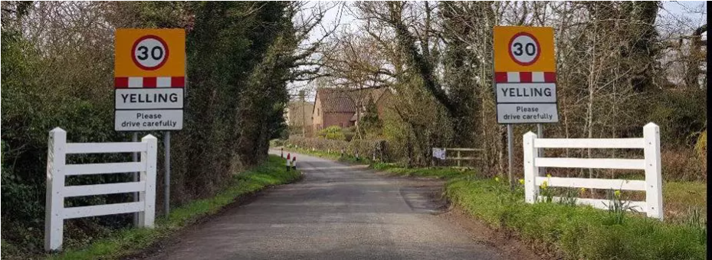
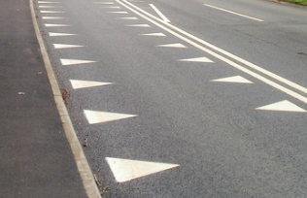
Buffer Zones Costs
40 mph Haslingfield Road, Comberton Road, Wimpole Road (Hamlet) £3-4k each
Village gates £3-4k each
Costs for 7 village gates and 40 mph buffer £30-40k
Two stage:
Haslingfield/Comberton/Wimpole Road £15-20k
A603/New Road £15-20k

Slide 5
20 mph School Zone
Speed at the end of Comberton Road and Start of New Road reduced to 20 mph
Speed cushions to control
Red road markings for school
Red road markings for cycle crossing
Warning signs
Sort out school/pedestrian signs
Giveway signs High Street

Slide 6
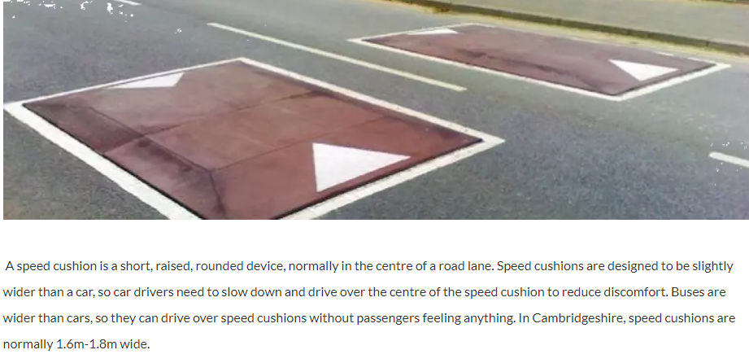
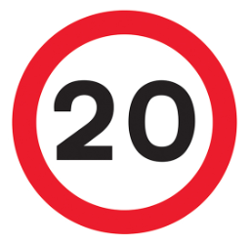
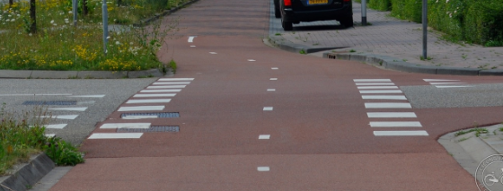
20 mph School Zone Costs
4 pairs of speed cushions £16-18k
Signage and road markings £4-5k
Single stage £20-25k

Slide 7
Road Narrowing
Visual appearance to make the roads look narrower
Cross hatching in centre of Comberton Road
Cross hatching in centre of Wimpole Road
Cross hatching in centre of Haslingfield Road
Add 40 mph footprint repeaters on Cambridge Road and more 40 mph repeater signs

Slide 8
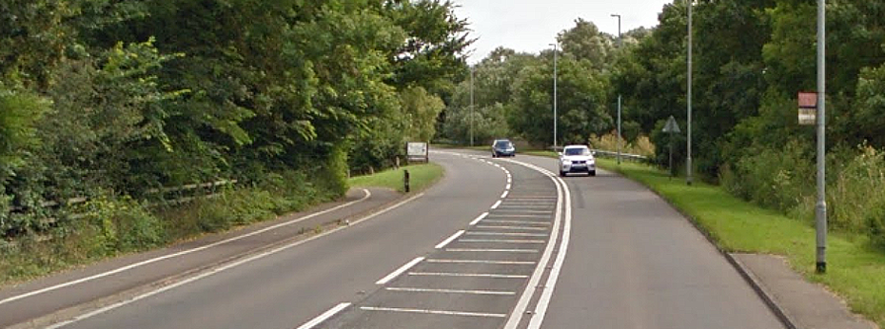
Road Narrowing Costs
Each road £3-4k
40 mph repeaters on 40 mph sections £2.5-4k
Total cost £11.5-16k

Slide 9

Safe Crossing
Centre of village at the junction of High Street, School Lane, Comberton Road and New Road. Not possible to install a controlled crossing because of the complex junction without massive changes and investment. Red “elephants” footprint suggested as a the best option.
Haslingfield Road and Wimpole Road. Install road narrowing and change layby/pavement. Away from junction (similar to the narrowing at Wallis Garage)

Slide 10
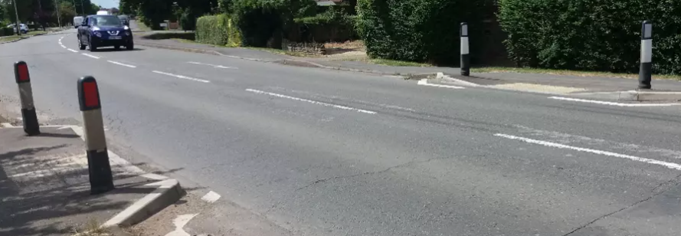
Safe Crossing Cost
Haslingfield Road /Wimpole Road only: £14-16k

Slide 11
Junction New Road/A603
Change junction so that farm vehicles or vehicle with trailers can use the junction.
Safe crossing for cyclists, pedestrians etc
Minimum cost £150k
Not feasible for the village to support this

Slide 12
Parking Concerns
Several locations where parking has been identified and reported as being a concern.
Parking is available on the recreation ground and at Burwash.
Yellow lines with parking restriction signs.

Slide 13
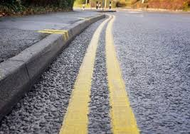
Parking Concerns Costs
Would need a good road surface.
£3-4k per road
Four locations would cost £12-16k

Slide 14
Speed Monitors
We have one Mobile or Moveable Vehicle Activated Sign (MVAS) or Speed Feedback Sign
Install more MVAS signs to remind drivers of speeds on roads
Current locations where we can install our MVAS include: Comberton Road (3), New Road (2), Haslingfield Road (1), High Street (1), Wimpole Road (1)
Not approved: Wimpole Road Hamlet (50 mph, old lampposts), Cambridge Road (old lampposts)

Slide 15
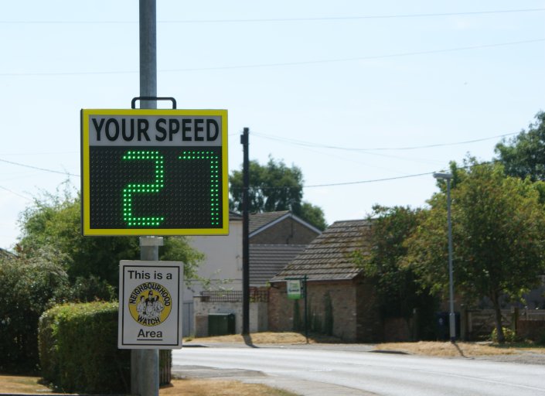
Speed Monitor
Purchase price is £3k per sign
We could buy 4 or 5 more
Battery needs charging every two weeks

Slide 16
Speedwatch
We can use MVAS equipment for speedwatch and also have an additional monitor for speedwatch
We have a number of approved speedwatch sites and applied for more
Current locations where we can Speedwatch include: Comberton Road (1), New Road (21, Haslingfield Road (1), High Street (1)
Awaiting approval: Wimpole Road (30 mph), Cambridge Road (40 mph), Comberton Road (2 more further out)

Slide 17
Pollution
Vehicle volume at the beginning of the year were so high that road capacity (720 per hour) was reached.
Result, queuing traffic on Comberton Road, New Road, Wimpole Road, Cambridge Road
Pollution is likely to be an issue in front of the school and along Wimpole Road
Traffic volume is hard for Barton to control but likely to increase if we get back to normal traffic patterns and with development at Cambourne West, Bourne Airfield, Orwell, Comberton, St Neots.

Slide 18
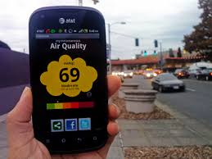
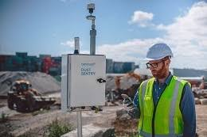
Pollution Monitor
South Cambs District Council pilot scheme to monitor pollution in Harston on the A10
Hand held monitors cost ~£200
(We have no bench mark data for pollution in Barton.)
Handheld monitor is relatively easy to fund
Other measures are to encourage more cycling, walking, engage with city schools to have school bus runs rather than parents driving children into Cambridge. Support local lobbying for Girton interchange

Slide 19
What are your priorities?
Scheme | Cost | Ranking | Private Funding? (Y/N) | Increase Precept? (Y/N)
40 mph Buffer A | £15-20k
40 mph Buffer B | £15-20k
20 mph School | £20-25k
Road Narrowing | £11.5-16k
Crossing (A603) | £14-16k
Double yellow | £12-16k
5 Speed monitors | £15k
New Road/A603 Junction | £150k
Buffer A is Comberton Road, Haslingfield Road, New Road and Wimpole Road at the 30 mph
Buffer B is Hamlet on A603 and gates at 30 mph and 40 mph on Cambridge Road

